Slide 1
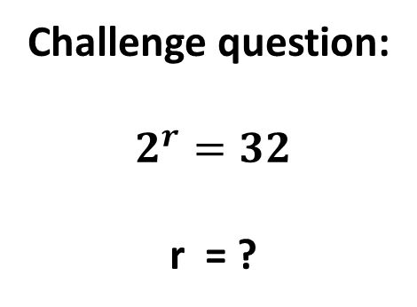
Lesson objective
Title: Writing expressions
Aim:
Be able to write algebraic expressions from authentic situations
Plan:
Daily review
  Substitution
Writing expressions
Need whiteboards
Challenge question:
$$2^{r}=32$$
r = ?

Slide 2
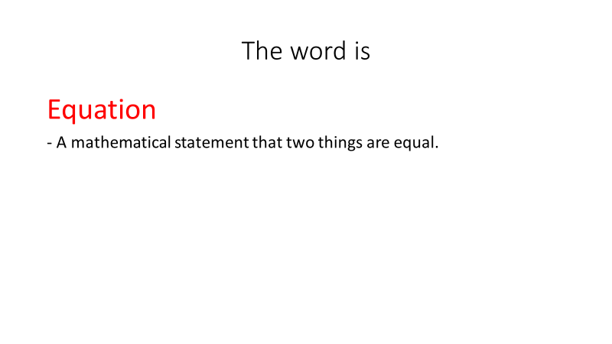
Daily review

Slide 3
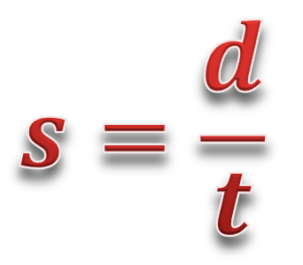



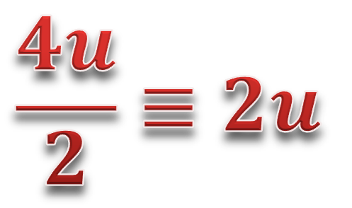

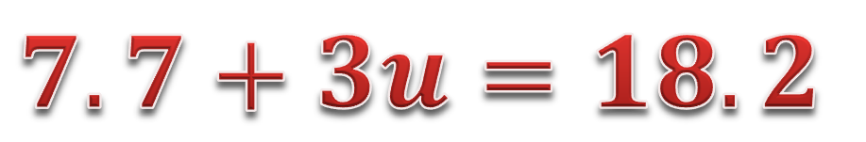
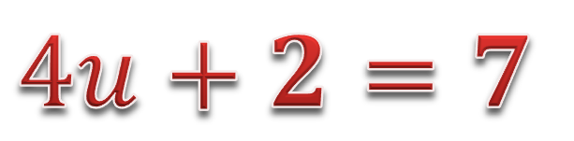
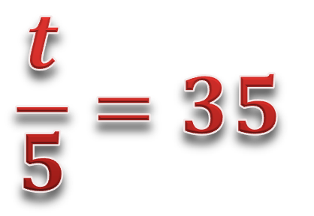
Forming expressions
Expression
Identity
or
Formula
Equation
$$2w+3v$$
$$4u+2=7$$
$$4u+3v$$
$$\frac{t}{5}=35$$
$$\frac{4u}{2}≡2u$$
$$s=\frac{d}{t}$$
$$7.7+3u=18.2$$
$$9z+2=190$$
$$9z+2≡9z+1+1$$

Slide 4
Substitution: Exercise book
If a = 4, b = 2 and c = -3
Substitute and solve:
a + b + c =
2a + 2b =
a – c =
9b – c =

Slide 5

Forming expressions
Algebra is a form of maths ‘code’.
Sometimes rather than doing a calculation, we want to set a rule.
For instance, adding to a user’s score when they achieve something in a videogame.
Think of algebra as the ‘language’ of maths. The word algebra comes from the Arabic, al-jabr, meaning “the reunion of broken parts”.

Slide 6

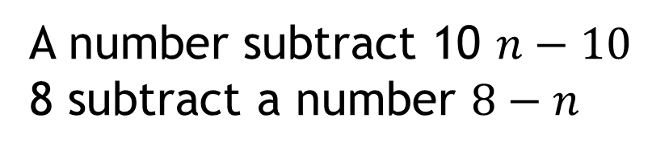
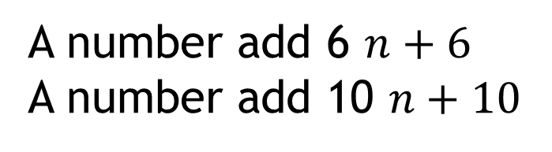
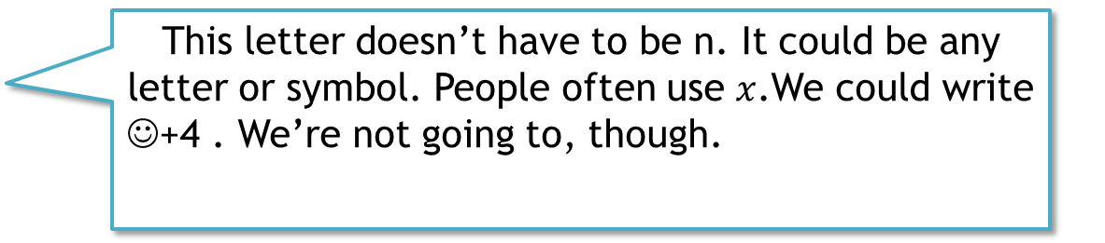
Forming expressions
‘Four more than a number’
$$n+4$$
This letter doesn’t have to be n. It could be any letter or symbol. People often use $x$.We could write
☺+4 . We’re not going to, though.
Write the following sentences algebraically.
A number add 6 $n+6$
A number add 10 $n+10$
A number subtract 10 $n−10$
8 subtract a number $8−n$
?
?
?
?

Slide 7
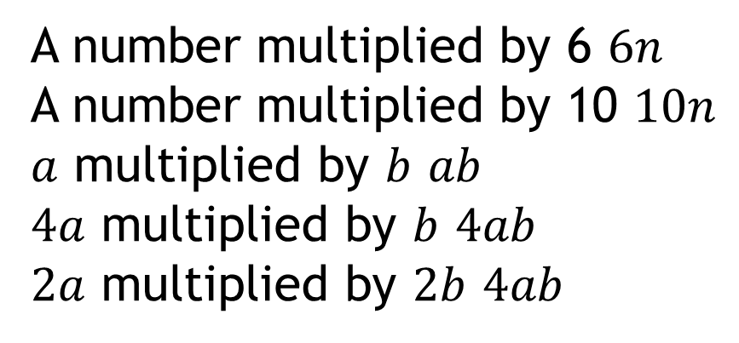
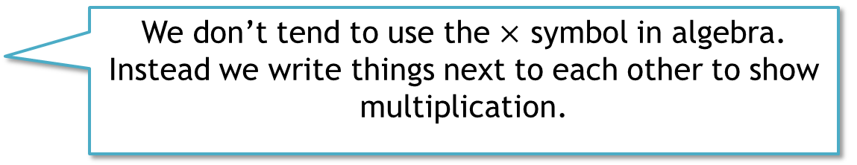
Forming expressions
‘Four lots of a number’
$$4n$$
We don’t tend to use the $×$ symbol in algebra. Instead we write things next to each other to show multiplication.
Write the following sentences algebraically.
A number multiplied by 6 $6n$
A number multiplied by 10 $10n$
$a$ multiplied by $b$ $ab$
$4a$ multiplied by $b$ $4ab$
$2a$ multiplied by $2b$ $4ab$
?
?
?
?
?

Slide 8

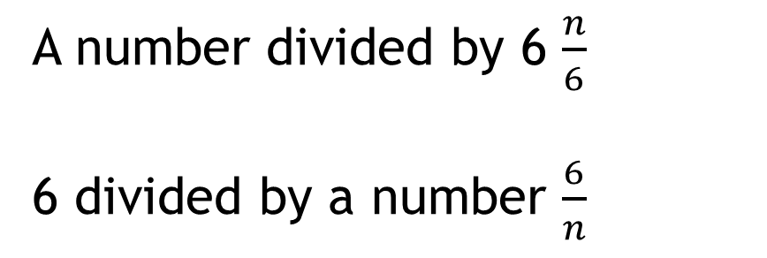
Forming expressions
‘A number divided by 5’
$$\frac{n}{5}$$
We tend not to use ÷ in expressions. We use fraction notation (writing a division as a fraction).
Write the following sentences algebraically.
A number divided by 6 $\frac{n}{6}$
6 divided by a number $\frac{6}{n}$
?
?

Slide 9

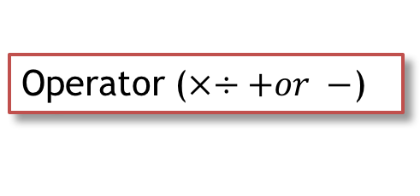
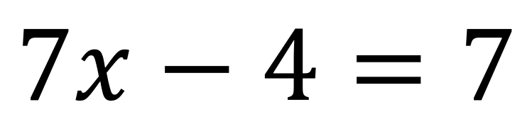
Forming expressions
There are names for different parts of an equation. It’s a good idea to learn them.
Operator ($×÷+or −$)
$$7x−4=7$$
Coefficient (the number used to multiply a variable)
A constant (something that doesn’t change).
Pronumeral : a symbol for something we don’t know or something that can change.

Slide 10


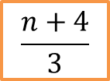
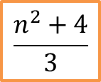
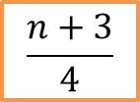

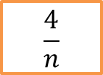

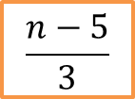




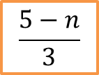



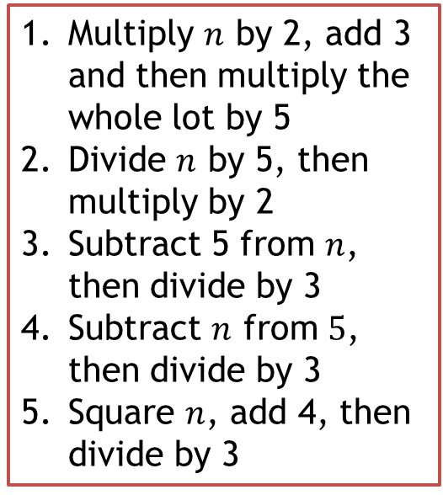

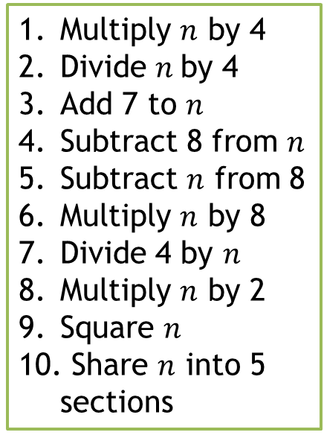
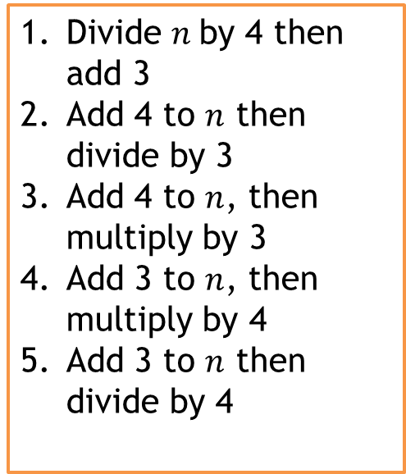


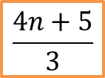
Forming expressions
Match the words to the algebra. Which piece of algebra code didn’t get matched? Write that code in English.
Multiply $n$ by 4
Divide $n$by 4
Add 7 to $n$
Subtract 8 from $n$
Subtract $n$ from 8
Multiply $n$ by 8
Divide 4 by $n$
Multiply $n$ by 2
Square $n$
Share $n$ into 5 sections
Divide $n$by 4 then add 3
Add 4 to $n$ then divide by 3
Add 4 to $n$, then multiply by 3
Add 3 to $n$, then multiply by 4
Add 3 to $n$ then divide by 4
Multiply $n$ by 2, add 3 and then multiply the whole lot by 5
Divide $n$ by 5, then multiply by 2
Subtract 5 from $n$, then divide by 3
Subtract $n$ from $5$, then divide by 3
Square $n$, add 4, then divide by 3
$$2n$$
$$5(2n+3)$$
$$3(n+4)$$
$$8−n$$
$$8n$$
$$\frac{n+4}{3}$$
$$\frac{n−5}{3}$$
$$\frac{n^{2}+4}{3}$$
$$2\left(\frac{n}{5}\right)$$
$$\frac{4n+5}{3}$$
$$\frac{4}{n}$$
$$\frac{n}{5}$$
$$\frac{n+3}{4}$$
$$\frac{5−n}{3}$$
$$\frac{n}{4}$$
$$8−n$$
$$n+7$$
$$4n$$
$$n^{2}$$
$$4(n+3)$$
$$\frac{n}{4}+3$$
Notes:
Student worksheet 1

Slide 11
Forming expressions
Match the words to the algebra. Which piece of algebra code didn’t get matched? Write that code in English.
Multiply $n$ by 4
Divide $n$by 4
Add 7 to $n$
Subtract 8 from $n$
Subtract $n$ from 8
Multiply $n$ by 8
Divide 4 by $n$
Multiply $n$ by 2
Square $n$
Share $n$ into 5 sections
Divide $n$by 4 then add 3
Add 4 to $n$ then divide by 3
Add 4 to $n$, then multiply by 3
Add 3 to $n$, then multiply by 4
Add 3 to $n$ then divide by 4
Multiply $n$ by 2, add 3 and then multiply the whole lot by 5
Divide $n$ by 5, then multiply by 2
Subtract 5 from $n$, then divide by 3
Subtract $n$ from $5$, then divide by 3
Square $n$, add 4, then divide by 3
$$2n$$
$$5(2n+3)$$
$$3(n+4)$$
$$8−n$$
$$8n$$
$$\frac{n+4}{3}$$
$$\frac{n−5}{3}$$
$$\frac{n^{2}+4}{3}$$
$$2\left(\frac{n}{5}\right)$$
$$\frac{4n+5}{3}$$
$$\frac{4}{n}$$
$$\frac{n}{5}$$
$$\frac{n+3}{4}$$
$$\frac{5−n}{3}$$
$$\frac{n}{4}$$
$$8−n$$
$$n+7$$
$$4n$$
$$n^{2}$$
$$4(n+3)$$
$$\frac{n}{4}+3$$

Slide 12


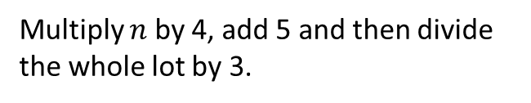

















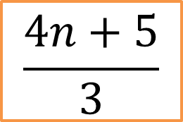
Forming expressions
Match the words to the algebra. Which piece of algebra code didn’t get matched?
$$4n$$
Divide $n$by 4 then add 3
Add 4 to $n$ then divide by 3
Add 4 to $n$, then multiply by 3
Add 3 to $n$, then multiply by 4
Add 3 to $n$ then divide by 4
Multiply $n$ by 4
Divide $n$by 4
Add 7 to $n$
Subtract 8 from $n$
Subtract $n$ from 8
Multiply $n$ by 8
Divide 4 by $n$
Multiply $n$ by 2
Square $n$
Share $n$ into 5 sections
$$\frac{n}{4}+3$$
Multiply $n$ by 2, add 3 and then multiply the whole lot by 5
Divide $n$ by 5, then multiply by 2
Subtract 5 from $n$, then divide by 3
Subtract $n$ from $5$, then divide by 3
Square $n$, add 4, then divide by 3
$$\frac{n}{4}$$
$$5(2n+3)$$
$$n+7$$
$$\frac{n+4}{3}$$
$$n−8$$
$$2\left(\frac{n}{5}\right)$$
$$8−n$$
$$3(n+4)$$
$$\frac{n−5}{3}$$
$$\frac{4}{n}$$
$$4(n+3)$$
$$2n$$
$$\frac{5−n}{3}$$
$$n^{2}$$
$$\frac{n+3}{4}$$
$$\frac{n^{2}+4}{3}$$
$$\frac{n}{5}$$
$$\frac{4n+5}{3}$$
Multiply $n$ by 4, add 5 and then divide the whole lot by 3.

Slide 13
Forming expressions
5 QUICK QUESTIONS CHECK
Now it’s time to check your learning.
You’ll see five questions.
The questions have a 30 second timer
How many can you get right?

Slide 14

Forming expressions
Question 1
Write in words
$$5v+2u$$
Timer

Slide 15
Forming expressions
Question 2
Write an expression
5 lots of $x$, plus 7
Timer

Slide 16
Forming expressions
Question 3
Write an expression
9 added to$x$, divided by 5
Timer

Slide 17
Forming expressions
Question 4
Write an expression
$a$ multiplied by $b$, then divided by $c$
Timer

Slide 18
Forming expressions
Question 5
Write an expression
$a$ divided by $b$, then add 6
Timer

Slide 19

Forming expressions
Your answers:
5 lots of $v$, added to 2 lots of $u$
$5x+7$
$\frac{9+x}{5}$
$\frac{ab}{c}$
$\frac{a}{b}+6$

Slide 20




Problem Solving Question
Work out an expression for the perimeter
$$x$$
$$5x$$
$$x$$
$$5x$$

Slide 21
Write an equation
Perimeter is the TOTAL length around the outside of the shape.
Write an expression for the perimeter:
4x + 2
2x
2x
6x + 4

Slide 22
Challenge question
The base of this rectangle is 4 times its height. Use algebra to write an expression that could be used to calculate the perimeter of the rectangle.
H

Slide 23
Reflection
Aim:
Be able to write algebraic expressions from authentic situations

